Slide 1
University of Basrah College of Medicine/ Department of Human Anatomy First Class Medical Biology

Slide 2
Classification of Epithelia
Balqees Alasfoor

Slide 3
Objectives
To know the types of epithelia
To Know the location and its function

Slide 4
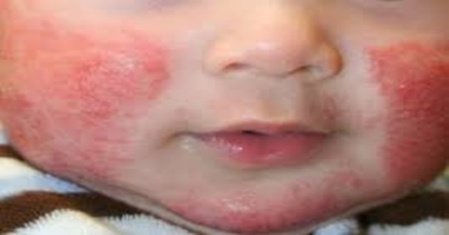
(skin diseases e.g. atopic dermatitis)
Rana is 6 months old girl present by her mother for red-itchy lesion on her face, the doctor examines her and told the mother she has eczema (skin disorder characterized by inflamed and itchy skin).

Slide 5
Epithelia are classified into two main groups according to their structures and function
1- Covering and lining epithelium
2- Glandular epithelium

Slide 6
Epithelia are classified based on the number of cell layers and the shape of the cells to:
simple and stratified epithelial tissue

Slide 7
Classification of Epithelial Tissue Cell Layers
Stratified (many layers)
Thick
Protective role
Regenerate from basal surface to replace apical surface cells that rub off or die
Cells differ in shape at apical and basal surface. (named for apical surface)
Simple (one layer)
Thin, no protection
Sparse cytoplasm
Found where rapid diffusion is a priority (ex. kidneys, lungs)

Slide 8
Simple Epithelium
Only one layer of cells, all of which are in contact with the basal lamina.
Depending on the shape of the cells, simple epithelia can be further divided into:
1-Simple squamous --- One layer of flat cells nuclei are flat and parallel to the free surface.
Examples: flat endothelium lines blood and lymphatic vessels.

Slide 9
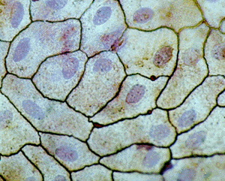
Simple Squamous Epithelium– cells fit like tiled floor
nucleus
Squamous cells

Slide 10
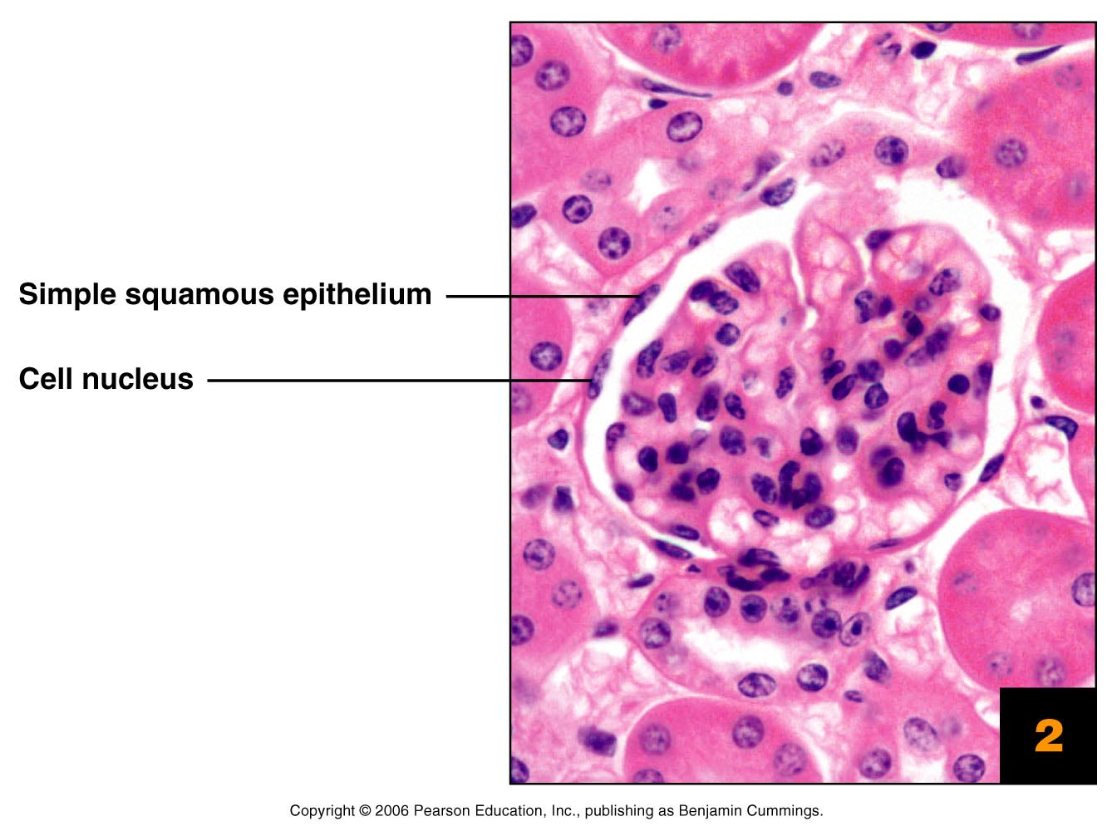
Simple Squamous Epithelium (side view/cross section)
– cells look like fried egg
Figure 4.2

Slide 11
2-Simple cuboidal
One layer of square cells. The nuclei are round and situated in the middle of the cell.
Example: thyroid , kidney tubules.

Slide 12
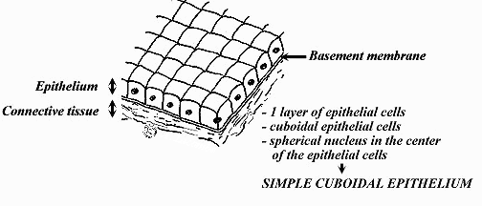
Simple Cuboidal Epithelium
Function and Location
Secretion and Absorption
Covers walls of SMALL ducts in glands, kidney tubules and ovaries
One layer
Cubed

Slide 13
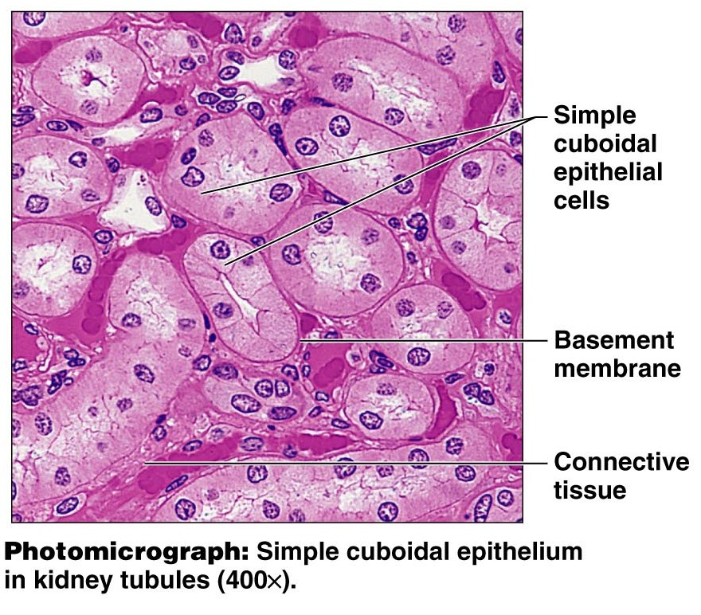

Slide 14
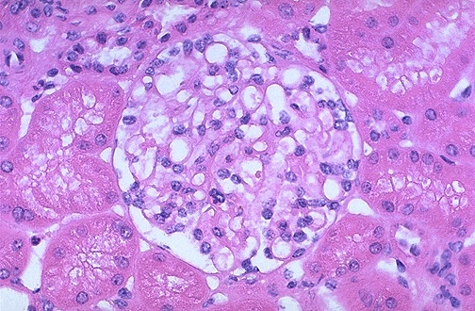

Slide 15
3-Simple columnar
One layer of tall cells the nuclei are oval and parallel to the axis of the cell and situated at its base.
Example: absorptive epithelium in the intestine
.
There are two types of simple columnar E.T.:
Simple columnar ciliated
Simple columnar non ciliated
.

Slide 16
A-Simple ciliated columnar epithelium
The apical surface of the cells is covered with cilia.
E.X., female reproductive system as uterus, uterine tube and oviduct,
Also found in small bronchi of lung.

Slide 17
B-Simple nonciliated columnar epithelium
It is lined most of digestive tract (stomach, intestine, and gall bladder).
This type offer protection, lubrication, absorption and secretion.

Slide 18
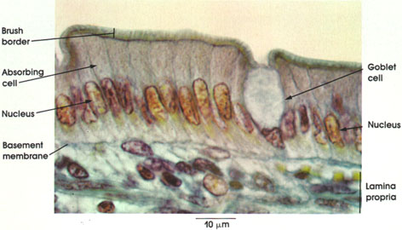

Slide 19
Pseudostratified Epithelium
This kind of epithelium contains basal and columnar cells resting on the basal lamina.
The basal cells sit on the basal lamina but do not reach upward.
Only the columnar cells (also sitting on the basal lamina) reach the free surface.

Slide 20
There are two types of pseudostratified E.T.
1- Pseudostratified nonciliated columnar epithelium
E.X.,duct of salivary gland, epididymis.
2- Pseudostratified ciliated columnar epithelium
The cells at apical surface are ciliated
E.X., trachea, bronchi of the lung, and nasal cavity.

Slide 21
Pseudostratified Epithelium
Functions
Protection
Secretion
transport of particles out of respiratory tract

Slide 23
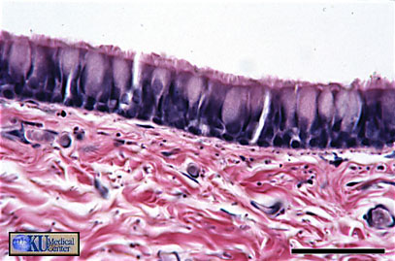
LUMEN
Cilia
Basement Membrane
Multilevel nuclei

Slide 25
Stratified Epithelium
Two or more than two layers of cells
Only the cells of the bottom-most basal layer are in touch with the basal lamina.
The shape of the cells closest to the basement membrane is quite different from that of the cells at the top, near the lumen.

Slide 26
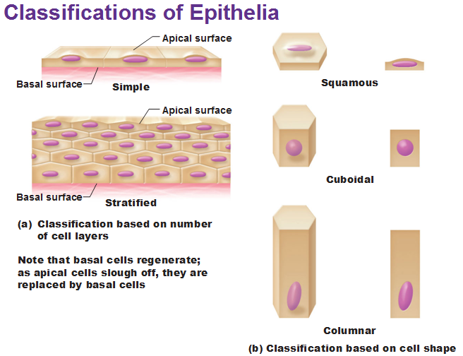

Slide 27
The stratified epithelia are further classified according to the shape of the cells at the free surface.
1-Stratified squamous
This can further be divided into:
Stratified squamous non-keratinized --- multiple layers of cells with those in the outer layer displaying nuclei. Examples: esophagus .

Slide 28
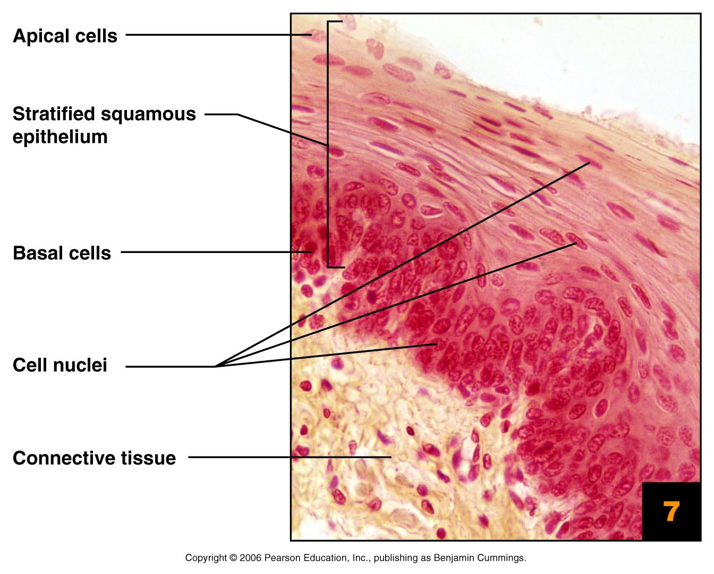

Slide 29
Stratified Squamous Keratinized Epithelium
Structure
Multiple layers of cells that are keratinized ,cells often cuboidal or columnar (polyhedral cells) below the apical squamous layer.
In the highly keratinized epithelium such as the epidermis of the skin, nuclei are absent in the outer layer.

Slide 30
Function and Location
Protection
Keratin (protein) is accumulated in older cells near the surface – waterproofs and toughens skin
Location
Skin( keratinized), mouth & throat

Slide 31
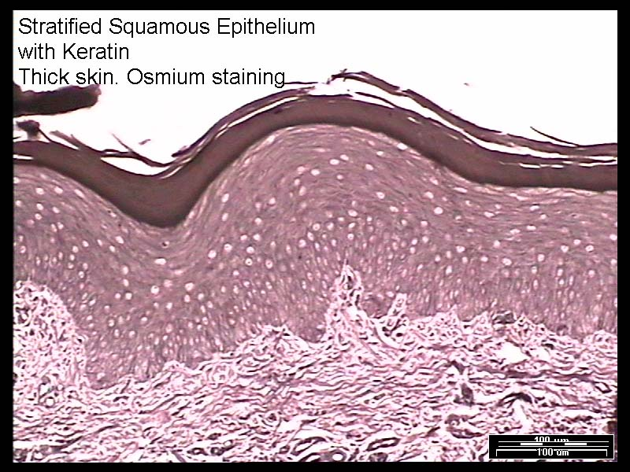
keratin
Squamous
Cuboidal
Columnar
Basement Membrane
Dense-Irregular Connective Tissue

Slide 32
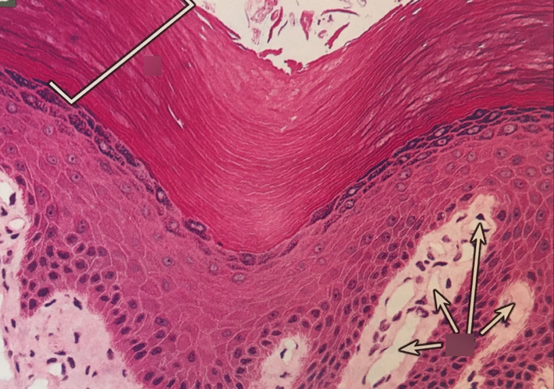

Slide 33
In the moderately keratinized (para-keratinized), nuclei may be still present in the outer layer of the cells.
E.g.: Cells that lining the cheek

Slide 34
Stratified cuboidal and Stratified columnar are less common and can be found in some secret
Functions
protection and secretion.

Slide 36
Transitional Epithelium (urothelium)
Composed of the following layers:
1-Asingle layer of small basal cells.
2- An intermediate region has from one to several layers of columnar cells.
3-Asuperficial layer is very large polyhedral or bulbous cells called umbrella cells.

Slide 37
This type of epithelium is transitional between stratified squamous and stratified columnar epithelium according to the degree of distension of bladder.
In contraction state (unstretched condition), it is composed of many layer.
In distention state (stretched condition), the cells are change in shape where the surface layers become long and flattened cells.

Slide 38
Cells of transitional epithelium are able to:
1-Withstand the hypertonic effects of urine.
2-protect underlying cells from toxic solution.
3-Have ability to adjust their relationships with one another.

Slide 39
Locations
Urinary bladder
Ureter
Upper part of urethra

Slide 40
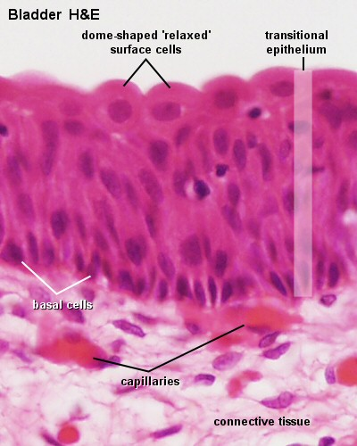

Slide 41
Eczema (atopic dermatitis)
The term atopic refers to a collection of conditions that involve the immune system (immune system activation, genetics, environmental triggers and stress), while dermatitis refers to inflammation of the skin.
The eczema is an inflammatory skin condition (the immune system overacts to small irritants or allergens) that can causes dry scaly, red and itchy skin.

Slide 42
Conclusion
Epithelial tissue basically classified in two types:
simple and stratified.
According to the shape of cells , epithelial tissue can be divided into:
Squamous
Columnar
cuboidal

Slide 43
Pseudostratified Epithelium contains basal and columnar cells resting on the basal lamina.
Transitional Epithelium is specialized to distend (stretch) as the urinary bladder fills .

